Slide 1
FUTURE OF RETAIL: Economic Apocalypse or Economic Catalyst?

Slide 3
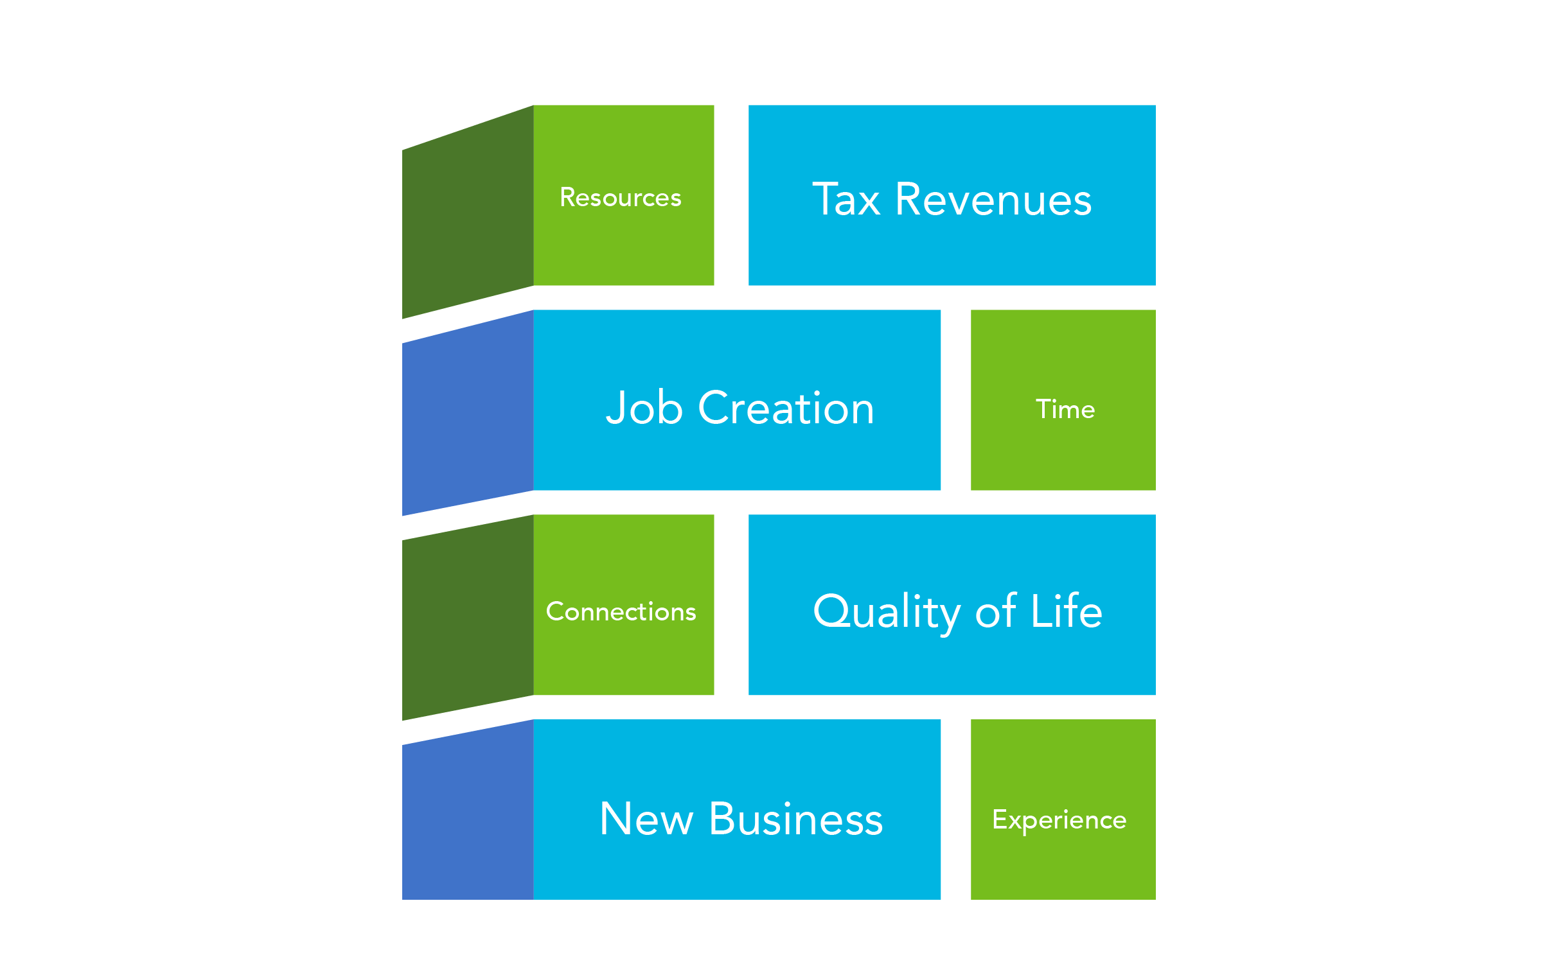




Goals
Challenges
Notes:
Increased sales/property tax revenues. Attracting desired business that improve the quality of life. Create jobs for the community.
Transition: The process we take to achieve these results is:

Slide 4
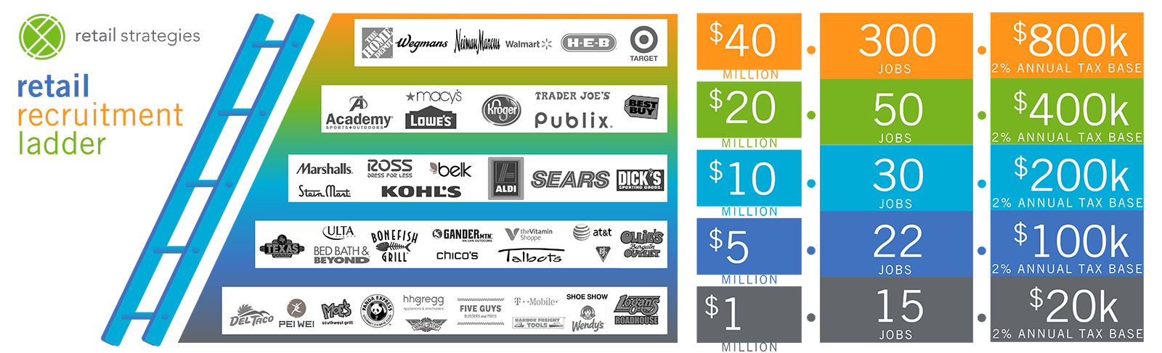
quality of life, jobs, tax revenue
Retail Return

Slide 5

New Normal in Retail Development is the Public Private Partnership [P3]

Slide 6
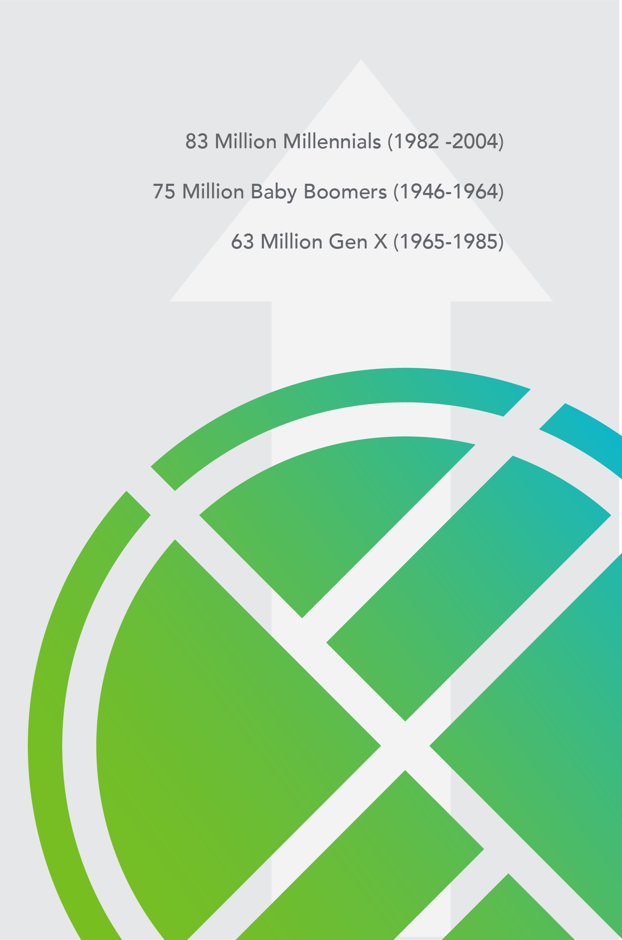
rise of the
millennial

Slide 7
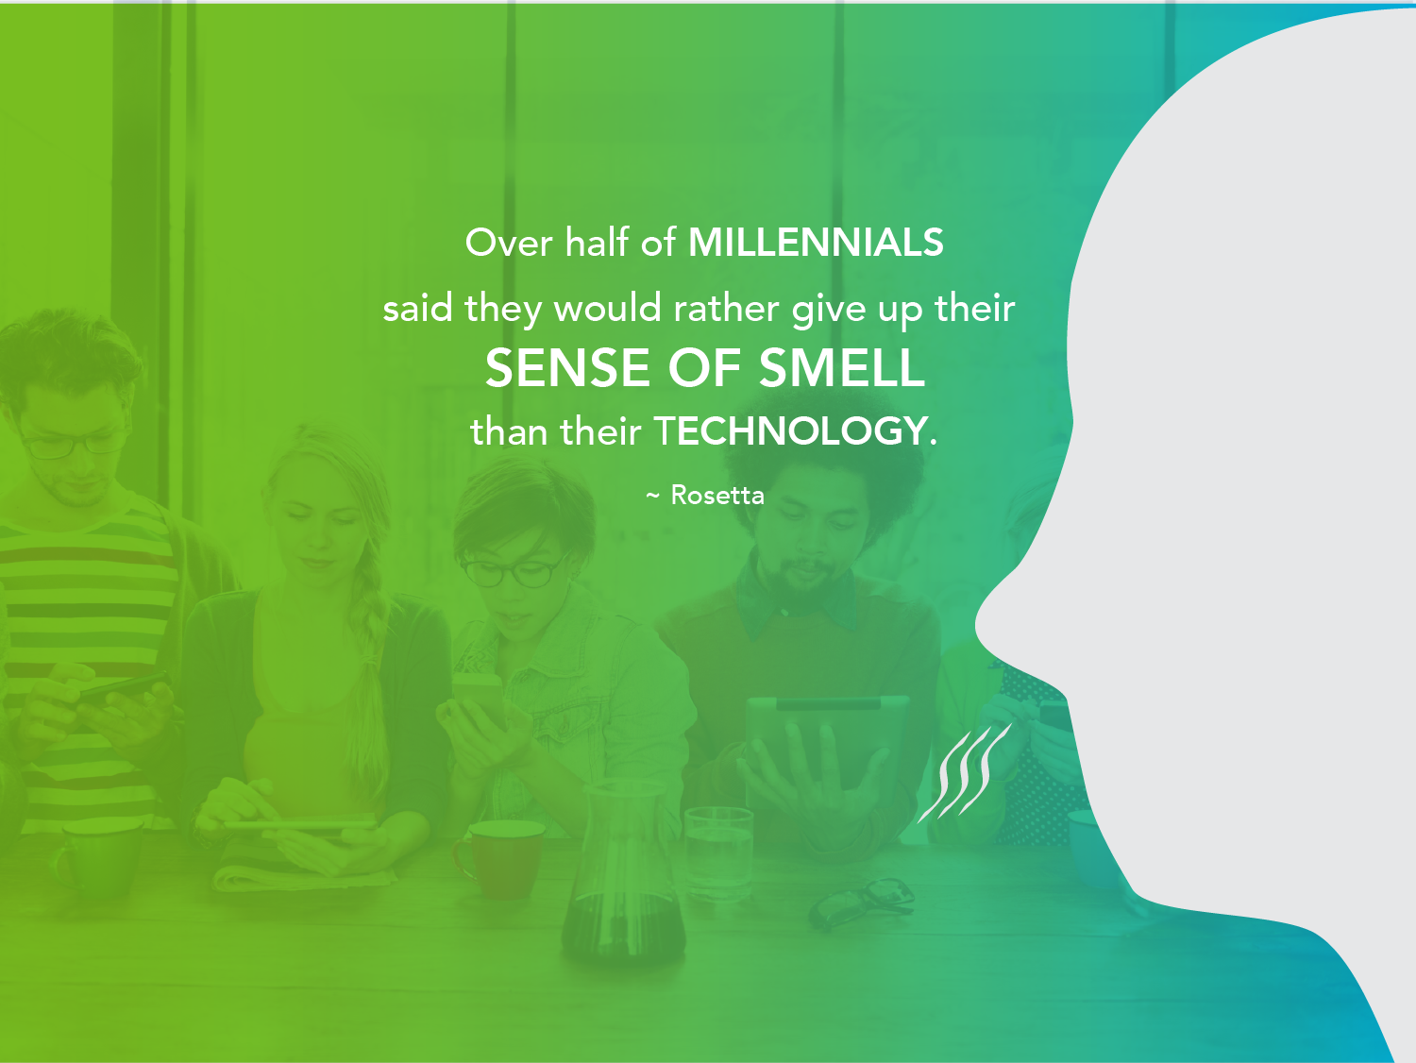
Notes:
FOMO

Slide 8

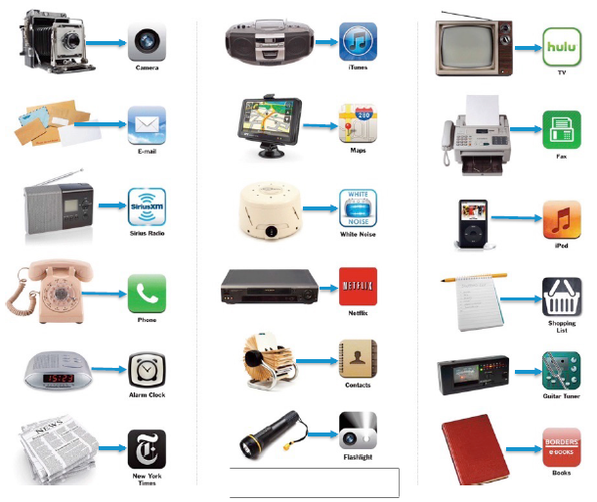
=
lacy@retailstrategies.com

Slide 9
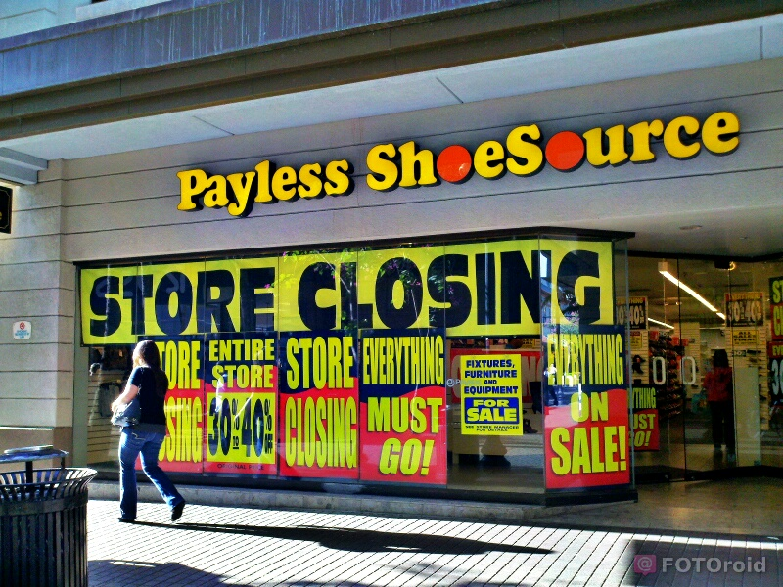
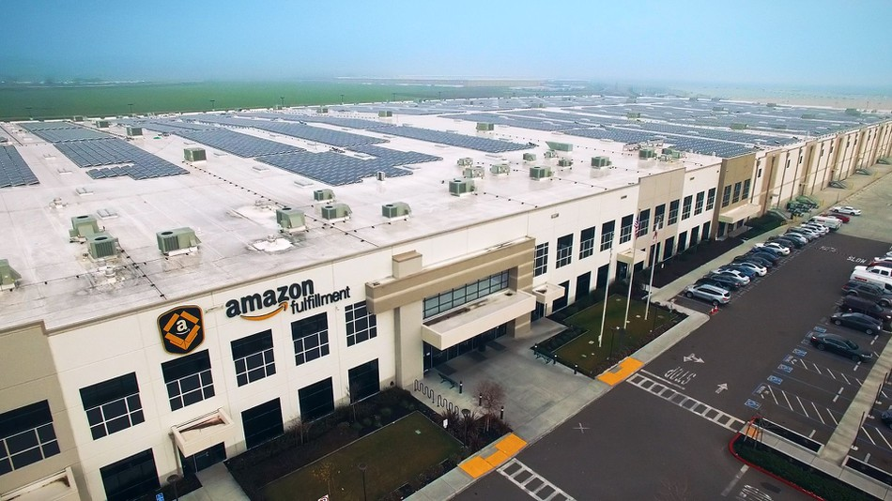
What We Know
Retailers Close Store Every Year
Rebalancing Store Portfolio’s is Normal
“Fail Quickly” – Mantra from the Great Recession
Macro Events, like Anchor Closures, Effect Everyone
Bad News Sells
Amazon is the Villain
Amazon is a Threat but Not the Cause for Struggling Segments
Source: Lee Holman & Greg Buzek, IHL Group, “Debunking the Retail Apocalypse, August 2017

Slide 10




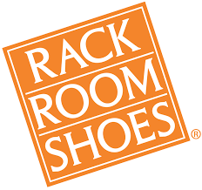


Debunking the Retail Apocalypse

Slide 11
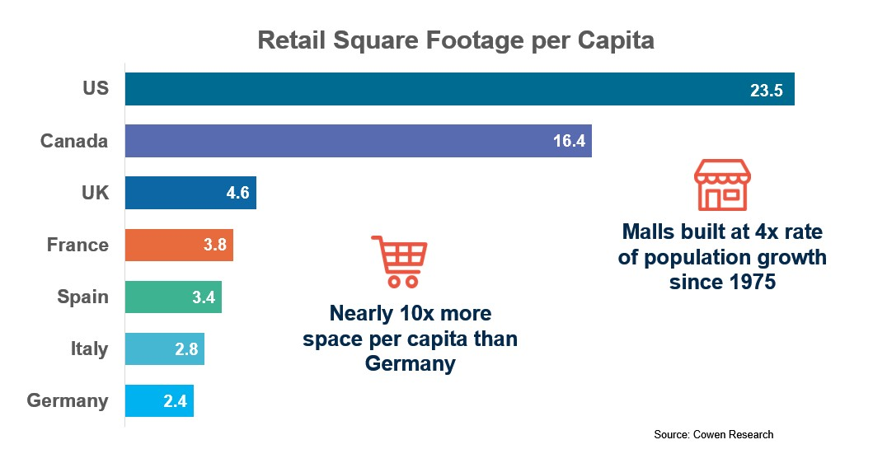
Overstored
Since 1970, Retail Mall Space Expanded at 4x the Rate of the Population Growth
Low Interest Rates Allowed Retailers to Grow Quickly
Many Retailers Expanded Beyond Their Ability to Service Customers
Retail Competition is so High that Any Hiccup Causes Problems
Source – Cowan Research
Source: Lee Holman & Greg Buzek, IHL Group, “Debunking the Retail Apocalypse, August 2017

Slide 12


Income & Price Changes
From 1996 – 2016 Core Consumer Goods have been Inflated by 55%
Significantly Higher Cost:
+200% - College Tuition and Textbooks
+125% - Childcare
+120% - Healthcare
+65% - Food and Beverage
+60% - Housing Costs
More Affordable:
-45% - Cellphone Service
-70% - Software
-72% - Toys
-95% - TVs
40% of the US Population Incomes have not Kept Up with Inflation
Result: Consumers Cannot Keep Up with Inflation and are Shopping at Lower Cost Retailers and Less at Higher Image/Brand Stores
Necessities
Luxury Items
Source: Lee Holman & Greg Buzek, IHL Group, “Debunking the Retail Apocalypse, August 2017

Slide 13
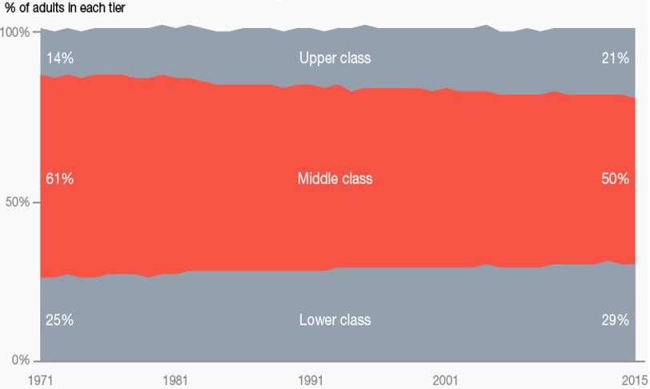
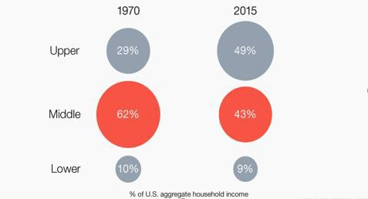
Shrinking Middle Class
Over the last 40 Years the Middle Class has Shrunk from 61% to 50%
Upper Class has Grown by 50% in Numbers
Lower Class has Grown from 25% to 29%
Over the last 30 Years Malls were Built in Areas thought to be Middle Class
Source: Pew Research Center
Source: Lee Holman & Greg Buzek, IHL Group, “Debunking the Retail Apocalypse, August 2017

Slide 14
Other Issues
Student Loan Debt
Over the Last 9 Years Student Loan Debt has Increased by 105%
Student Loan Debt has Become a Major Concern over the last 10 Years
Rise of Online Retail
Before, Consumers HAD to Shop in Store
Now, Retailers Must Make Consumers WANT to Shop In Store
20% of US Households now have Amazon Prime
Retailers Must Look in the Mirror
Retailers Prioritized Store Growth Over Customer Experience
Under invested in associate training, IT spending and inventory leading to 25% of Customers Leaving Their Store Without Buying at Least One Item They Intended to Buy
Source: Lee Holman & Greg Buzek, IHL Group, “Debunking the Retail Apocalypse, August 2017

Slide 15
The Real Story

Slide 16

Retail Sales Up
Retail Sales were Up $121.5b through the First 7 Months of 2017
That is the Annual Retail Trade for The Netherlands. This is just US Growth in 7 Months
Retail Sales from Nov. 1 2017 to Dec. 31st 2017 were up 4.9%
Fastest Growing Retail Segments
+8.4% - Convenience/Gas
+6.8% - DIY and Home Goods
+3.8% - Furniture
+4.0% - Cosmetics & Vitamins
+3.0% - Restaurants
+4.5% - Mass Merchants, Dollar Stores, Off-Price
+2.6% - Jewelry
+2.0% - Supercenters & Warehouse Clubs
+1.8% - Food and Beverage Stores
Declining Retail Segments
-8.1% - Sporting Goods
-4.3% - Department Stores
-1.3% - Electronics
-0.1% - Clothing
-0.9% - Shoes
-0.9% - Drug Stores/Pharmacies
Source: Lee Holman & Greg Buzek, IHL Group, “Debunking the Retail Apocalypse, August 2017

Slide 17
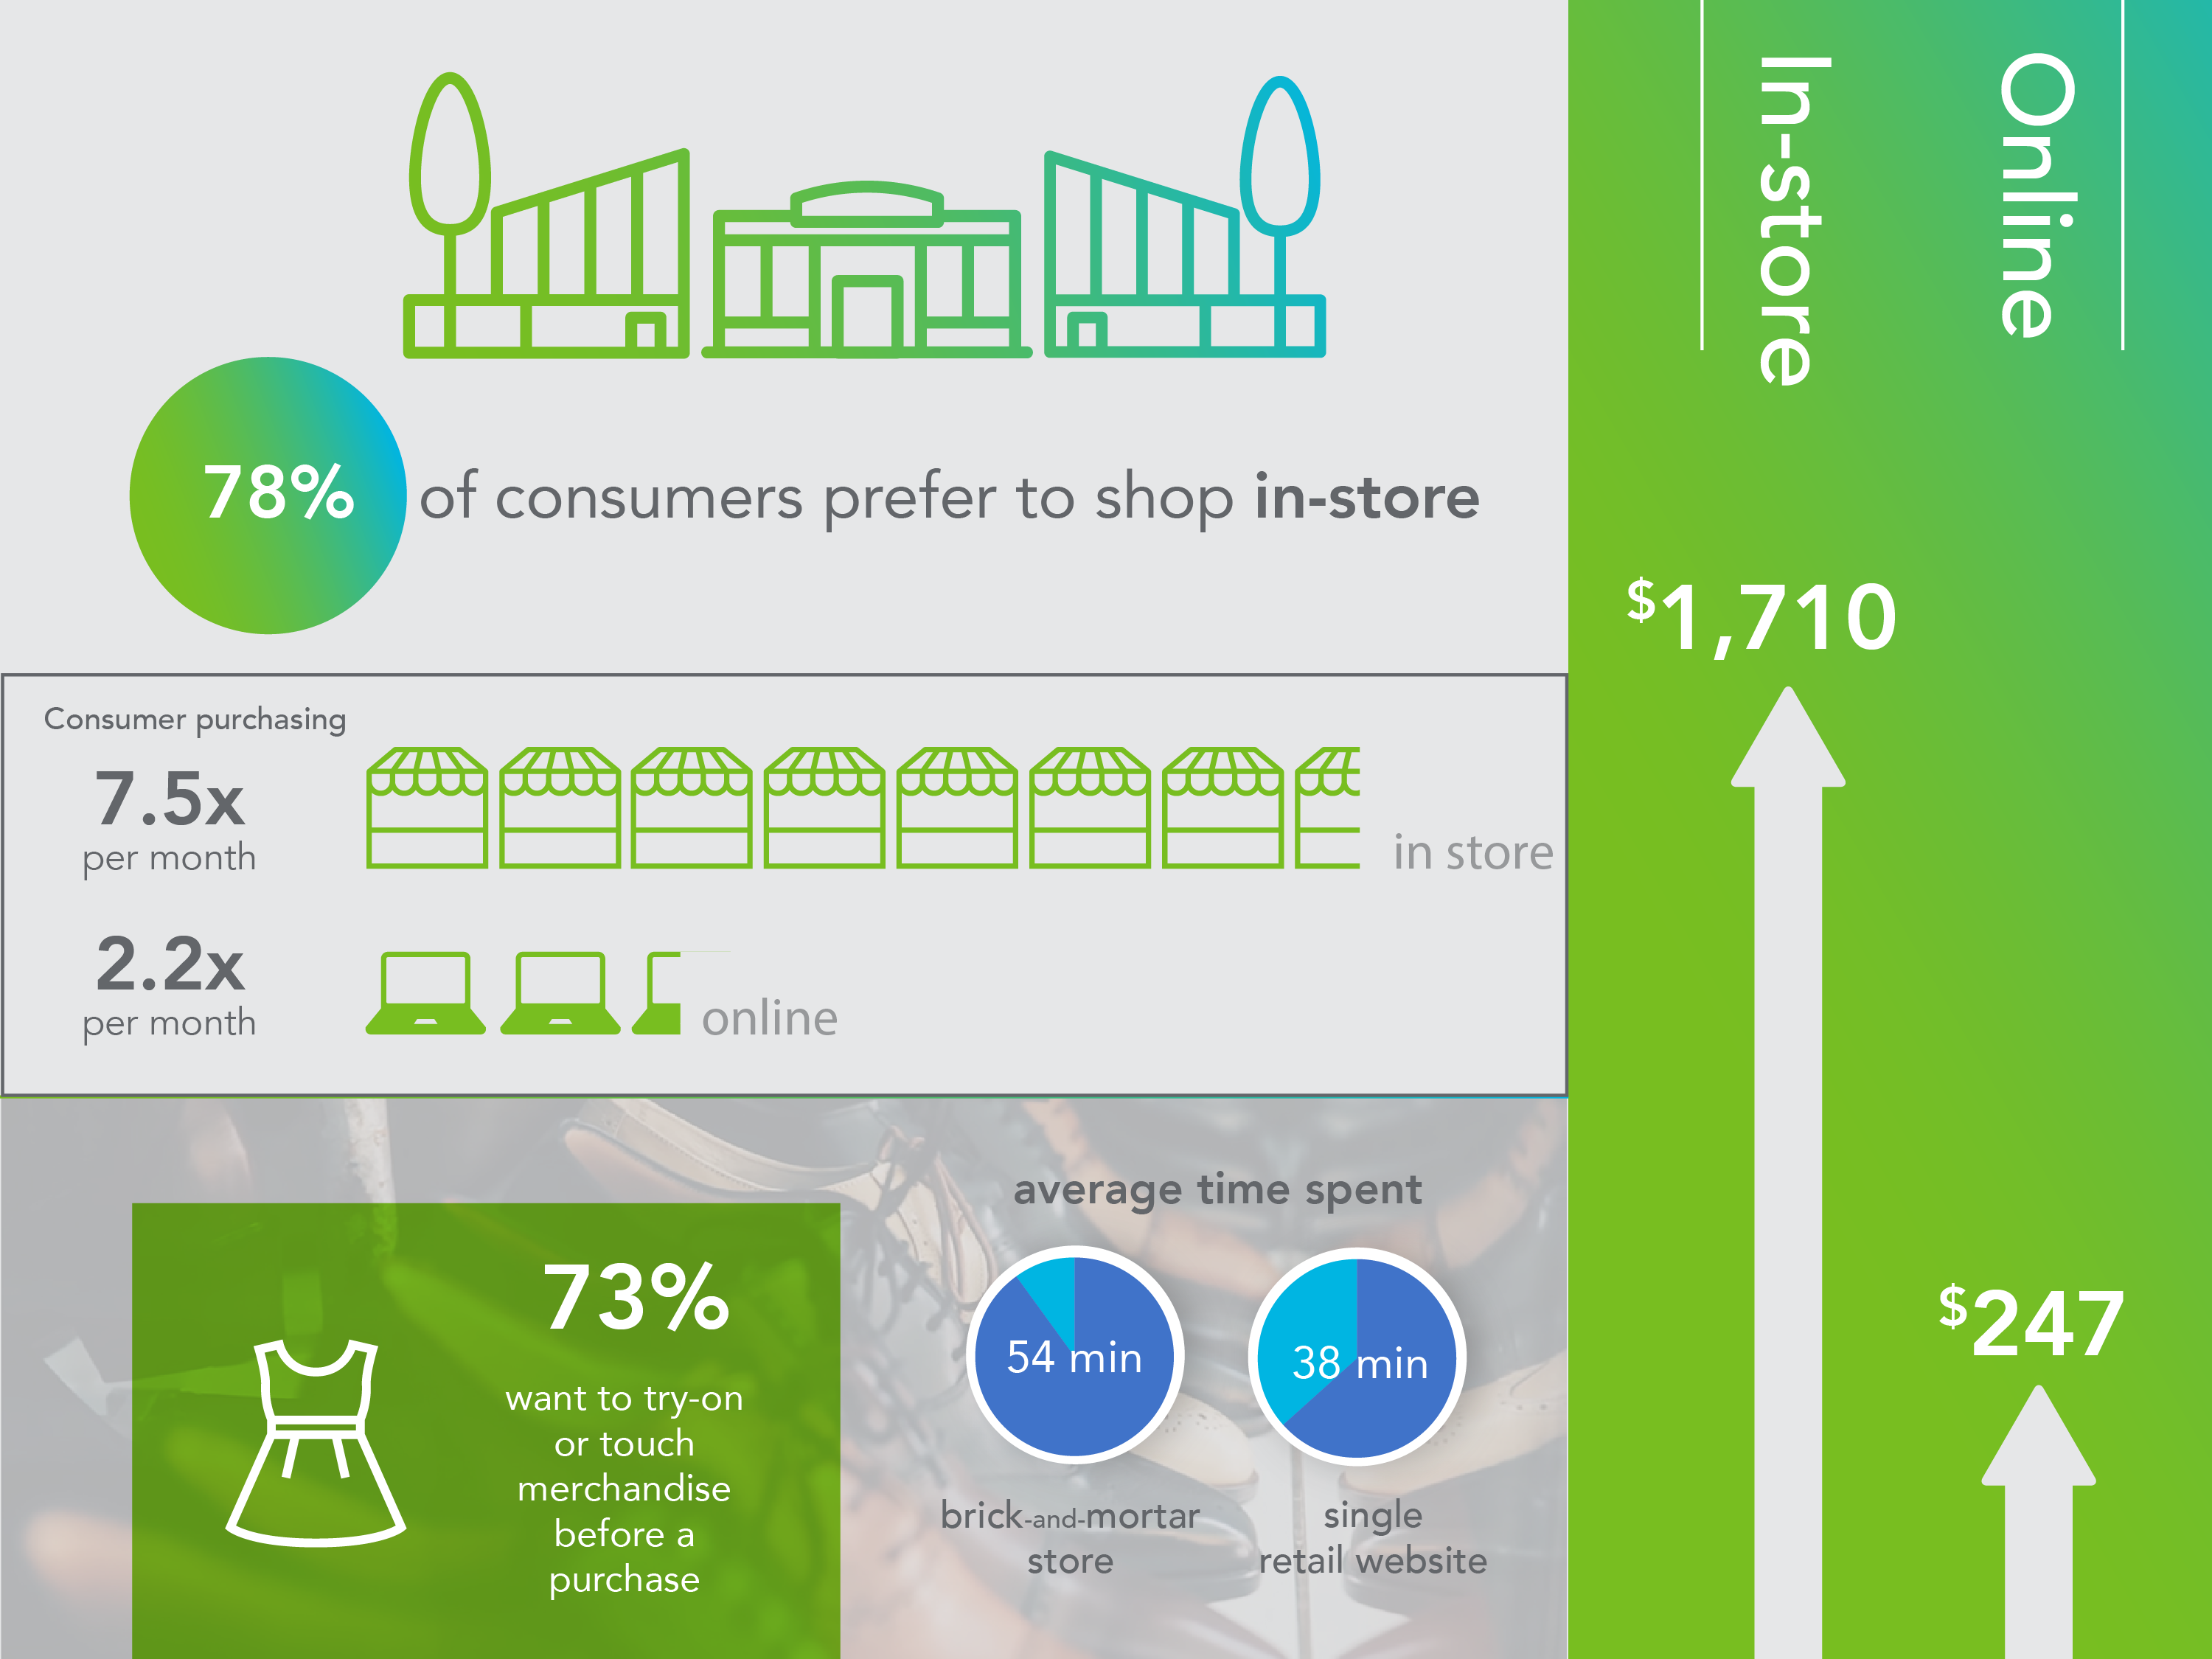
Online Sales
Online Sales Represents 9% of Total Retail
89% of Online Retail is from Retailers who are Solely Online (No Brick & Mortar)
Amazon’s Online Business is Estimated to be 13.9% of US Retail Growth YTD
This Does not Take in to Account the Whole Foods Acquisition
Conclusion: This is all Still Retail and Retailers who Focus on the Consumer Will Succeed
Source: Lee Holman & Greg Buzek, IHL Group, “Debunking the Retail Apocalypse, August 2017

Slide 18















Retail is Growing
% Net Opening Stores vs Net Closing
Superstores/WH Clubs
Convenience Stores Mass Merchandisers Specialty Softgoods Specialty Hardgoods
Drug Stores Food / Grocery
Fast Food Bar / Restaurants Department Stores
For each company
closing stores
2.7
are opening stores
Source: IHL Group, Company Reports
% Banners Closing Stores
% Banners Gaining Stores
Source: Lee Holman & Greg Buzek, IHL Group, “Debunking the Retail Apocalypse, August 2017

Slide 19
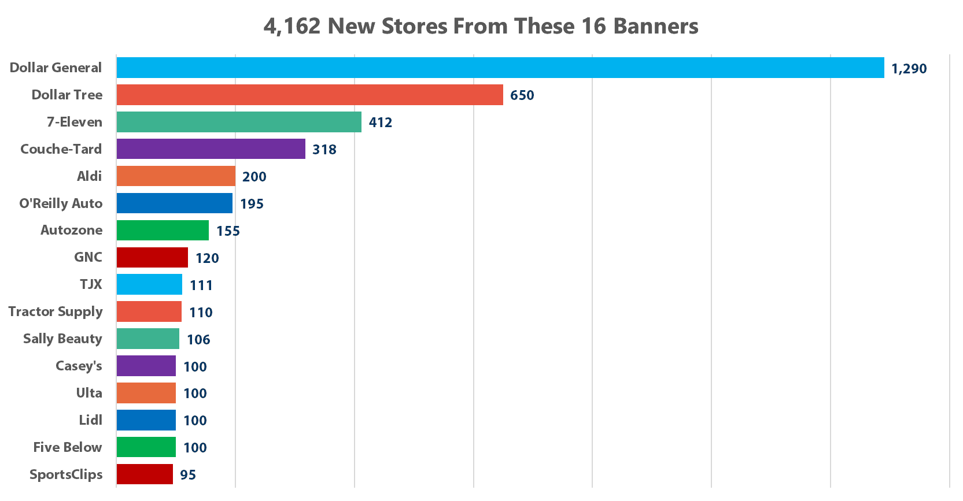
Retail Growth
Fastest Growing Retailers: Dollar, C-Stores, Beauty, and Specialty Hardgoods
What’s Growing Mirrors the Incomes of Consumers:
More Discounters
Less Mid-Range Luxury
Source: Lee Holman & Greg Buzek, IHL Group, “Debunking the Retail Apocalypse, August 2017

Slide 20
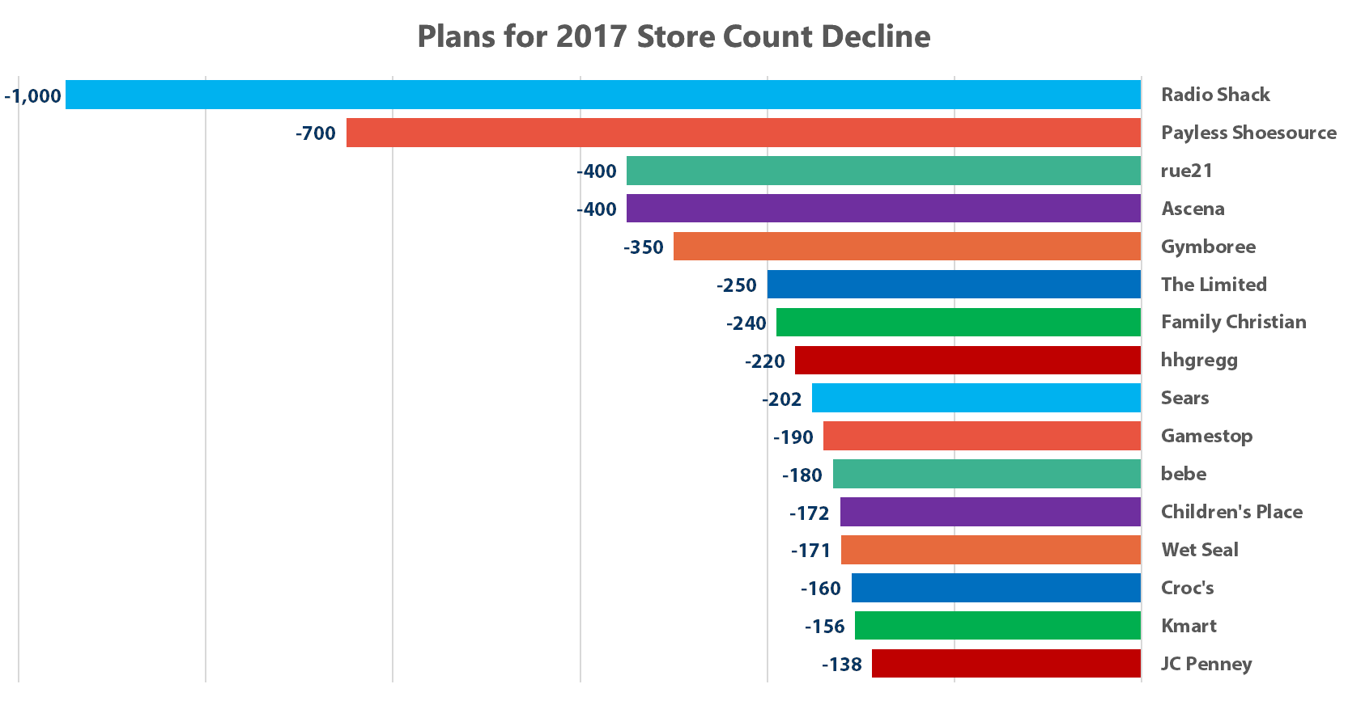
Retail Decline
These 16 Retailers Represent 48% of Closings
Many of these Retailers Have been Shrinking for a Decade
Outdated Business Models or Market Issues?
Source: Lee Holman & Greg Buzek, IHL Group, “Debunking the Retail Apocalypse, August 2017

Slide 21
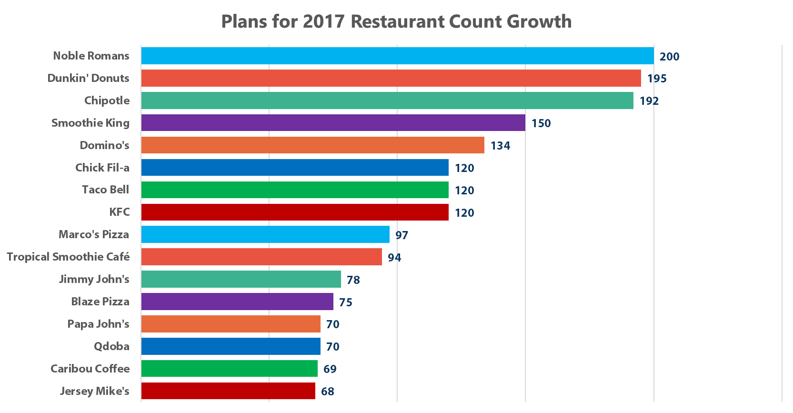
Restaurant Growth
Coffee & Pizza Driving Growth
Fast Food is the Fastest Growing
Source: Lee Holman & Greg Buzek, IHL Group, “Debunking the Retail Apocalypse, August 2017

Slide 22
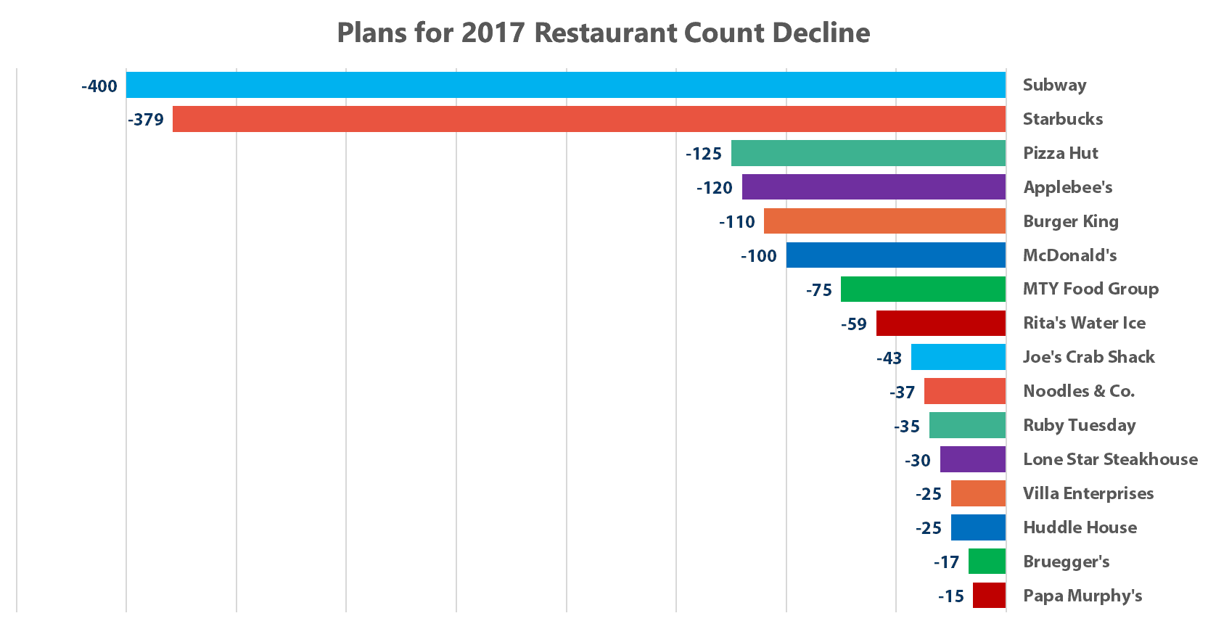
Restaurant Decline
400 Closings for Subway Represents Less than 3% of Their Store Total
Franchise Concepts Lends Itself to Faster Growth, Sometimes These Don’t Work Out
Table Service Chains are Struggling
Source: Lee Holman & Greg Buzek, IHL Group, “Debunking the Retail Apocalypse, August 2017

Slide 23
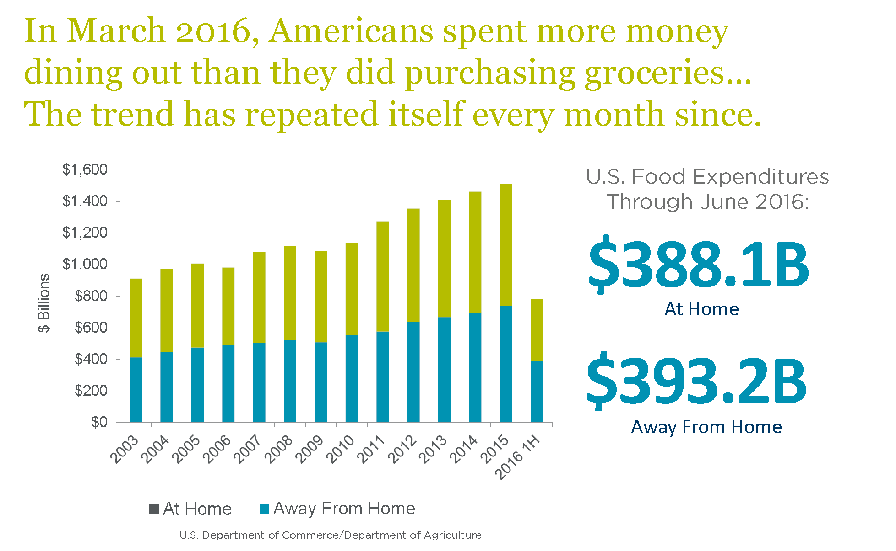
Restaurants

Slide 24

retail is not dying
it’s changing

Slide 25
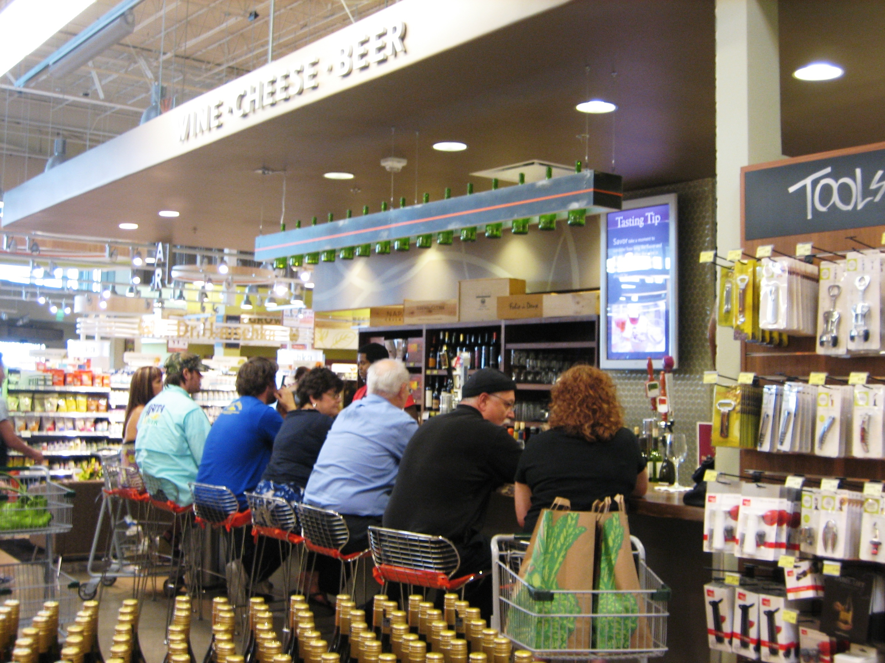
Restaurants vs. Grocery
Notes:
In march 2016, Americans spent more money dining out than they did purchasing in groceries. Trend continues.

Slide 26
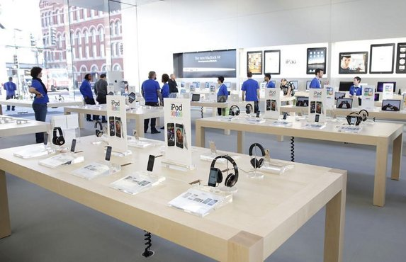
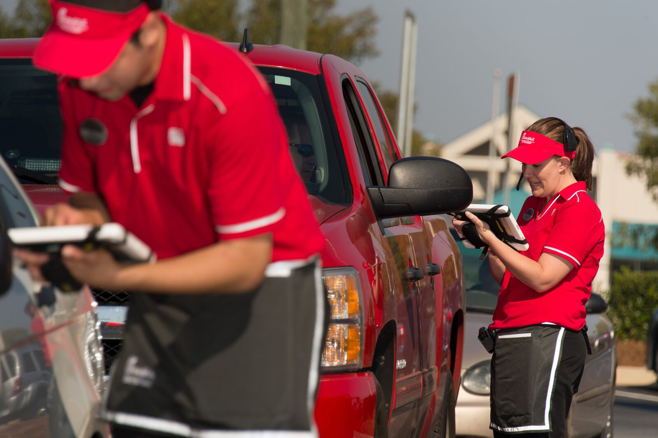
Improve The Experience
Retailers Have to Attract Consumers to Their Stores
Invest in Experience at the Store Level (Apple / Chick Fil A)
Investing in Their People Yielding Better Customer Service
In 2017, Consumers Most Value Their Homes & Experiences
Source: Lee Holman & Greg Buzek, IHL Group, “Debunking the Retail Apocalypse, August 2017

Slide 27
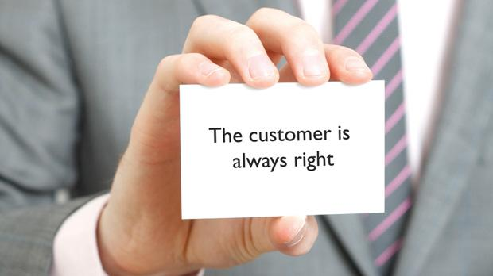
In Conclusion
Retail in the US is Right-Sizing and Retailers Need to Up Their Game
Retail is Constantly Changing
In 1990 we had 4 Wal-Mart Superstores, in 2000 we had 1,500+
Many People Thought This Would Have a Negative Effect but Retail not Only Survived, It Grew
US Population is Continues to Increase Building in Retail Growth
Consumers Value Experience, Retailers and Malls that Invest to Improve Shopping Experiences Will Thrive
Source: Lee Holman & Greg Buzek, IHL Group, “Debunking the Retail Apocalypse, August 2017

